Slide 1
205, Feb 23, Class 22
Final projects
Start building your procedure online
Ethics 2: Responsible Conduct of Research

Slide 2
Responsible Conduct of Research
Researcher processes with rigor and integrity
Don’t lie, cheat or steal
Data Manipulation
Forgery: fabrication or modification
Data selection
Eliminating all data inconsistent with the hypothesis
Bias in recruiting, protocol administration or data scoring

Slide 3
Analytic Flexibility
File drawer effect
Re-running or re-starting the experiment repeatedly until it “works”
“p-hacking”
Trying different analysis approaches until it “works”
Normal processes that seem similar
Pilot testing
Data exploration
Standard exclusion/filtering processes
When is it too much?

Slide 4
Reproducibility
Research that meets the p<.05 statistical criterion should replicate if repeated
Except for power issues or generalizability questions
Weak processes for research rigor make this less likely
Even typical lab processes risk inflating the estimated effect size
Replication crisis approaches
More rigor, fewer studies with greater confidence
More studies without increasing rigor, build in replications

Slide 5
Plagiarism
Citation strengthens reports
Novel findings have value
Build on existing ideas
Actual appropriation of others’ ideas
Scooping other labs
Pre/re publishing manuscripts
Authorial credit to collaborators and research team
Significant intellectual contribution
Definition varies across psychology, medicine for example
Not uncommon source of in-laboratory friction

Slide 6
Being Public
All aspects of the research process are auditable
Participant privacy must still be protected
Researchers protected from exposure to competing labs
Patent, copyright, and invention privacy
Publication
Full, fair & accurate reporting, making all resources available
Not always practically effective
Supplementary materials via journal website
Public availability of de-identified data
Does not always include excluded data

Slide 7
RCR Errors
Suppose a friend doing a research project said to you, “I’m sure my hypothesis is correct, so I’ll just give my participants a hint here and there to make sure the data come out properly.”
1. What kind of RCR violation is this?
2. What methodological approach should be used by this research to avoid this problem?

Slide 8
RCR Errors
A researcher doing a study on academic performance of students who have been diagnosed with ADHD. Some of the potential participants have refused to answer the question about their diagnosis, so the researcher contacts their medical provides without the participant’s knowledge.
3. What kind of research ethics violation has occurred here?

Slide 9
Intervention research
4. Give an example of a research study not included in the chapter for which it would be unethical to include a placebo/control group.
5. Why are rules requiring reporting of conflict of interest important for ensuring accurate and fair scientific processes and reports?

Slide 10
Training intervention
Targeted skill training
Shorter time course, 4-6 weeks
Large numbers of students, all getting identical content
Can memory theory be used to accelerate training?
Intervention to speed learning

Slide 11
Crossover Intervention Design
Test 1: A1 versus B1
Test 3: A1 versus A2
A
Assessment - 1
A1 Scores, Cohort A
T3
Assessment- 2
A2 Scores, Cohort A
Intervention Training
No training
Random assignment within a single class, half students to “A” cohort and half to “B” cohort
T1
B1 Scores, Cohort B
B2 Scores, Cohort B
No training
Intervention training
B
T2
Test 2: B1 versus B2

Slide 12
A Science Fair’s Teachable Moment
A science fair project done by an 8yo girl, “Does Skin Color Make a Difference?” (Boulder, Colorado)
2001 school science fair
School board panicked and censored the results for fear of “insensitivity”
Design: Two Barbie dolls, one white and one black. One Barbie is wearing a lavender (preferred) dress. The question is “which doll do you prefer?”
30 adults and children were asked. Adults consistently preferred the lavender dress (e.g., 27 of 30 times).
Among children, only 6 picked the lavender dress if the Black Barbie wore the dress.

Slide 13
Adults’ preference
Adults | Lavender | Other
Black-Lavender | 13 (.867) | 2 (.133)
White-Lavender | 14 (.933) | 1 (.067)
X²<1.00, p>0.50

Slide 14
Children’s preference
Children | Lavender | Other
Black-Lavender | 6 (.40) | 9 (.60)
White-Lavender | 15 (1.0) | 0 (.00)
Average rate choosing the Lavender dress is 21/30 = 0.70
Expected value (null hypothesis) = 10.5 Lavender, 4.5 Other
X²=12.86, p<0.001

Slide 15
Do Adults and Children react differently?
 | Lavender | Other
Adults | 13 (.867) | 2 (.133)
Children | 6 (.40) | 9 (.60)
Total | 19 (.633) | 11 (.367)
X²=7.02, p<0.01

Slide 16
Philosophical Ethical Challenges
When the experimental treatment is a benefit
Justice would normally mean equal benefits across groups
Intervention research on Monday
Coercion versus voluntary participation
Authority figures: supervisors, teachers
Financial rewards: incentivizing risk
Vulnerable populations
Children: depend on guardian
Mandatory reporting training for staff
Prisoners: cannot voluntarily consent
Research must be for prisoners’ benefit

Slide 17
For Mon 2/26
Chapter 19: Field research
Wednesday, Chapter 20
Developmental psychology and Neuropsychology
Friday, Exam 2
Project presentations March 4 and 6

Slide 18
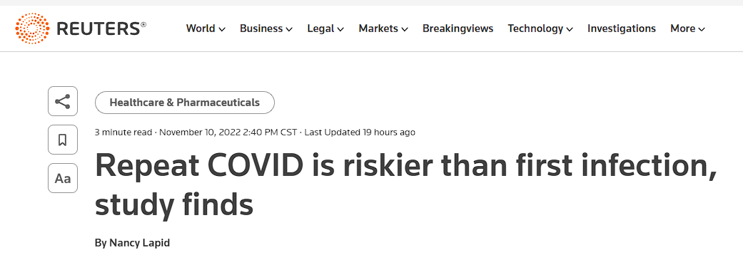
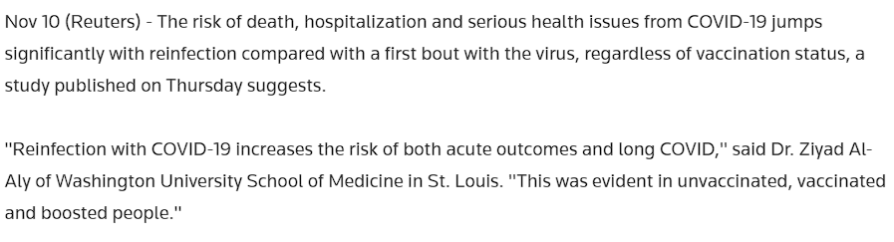

Slide 19
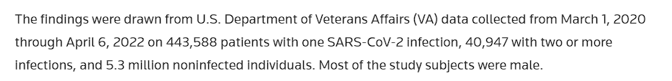
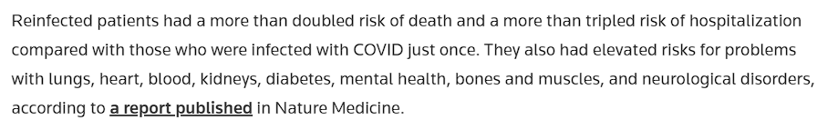
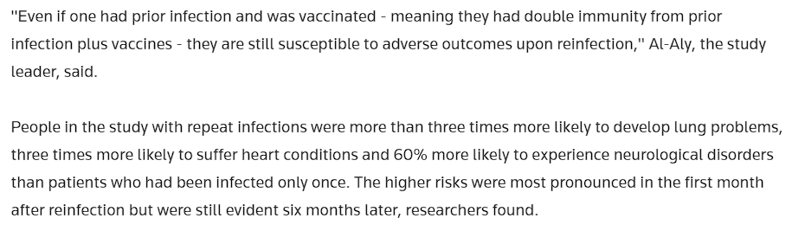

Slide 20
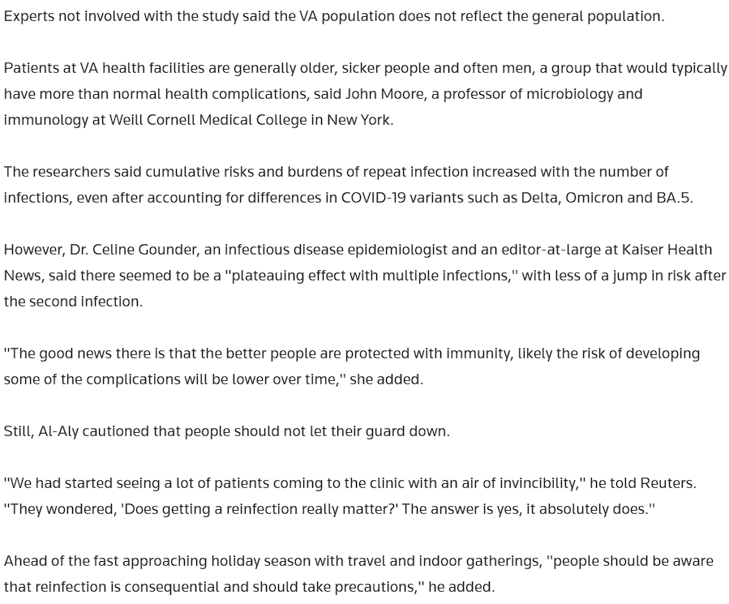

Slide 21
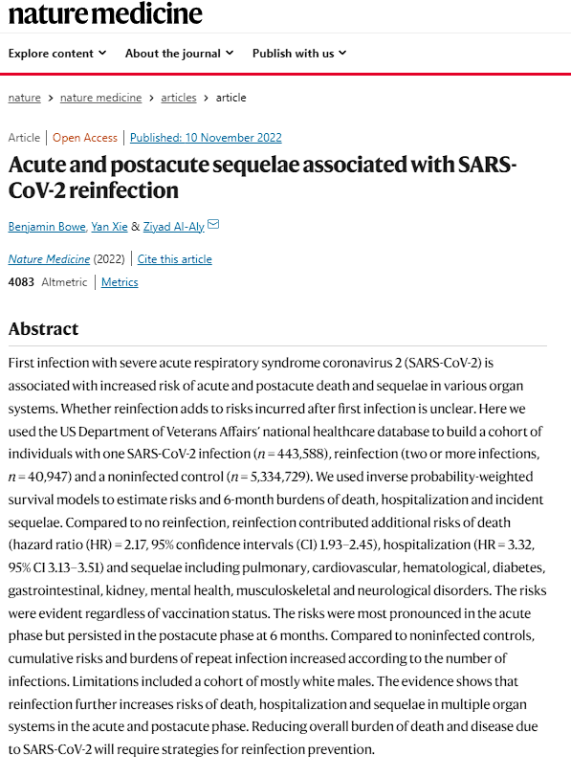
Key contrast
Re-infected versus one case not re-infected
What cannot be controlled properly in this non-experimental study?

